Slide 1
Welcome
let's get started

Slide 2
GROUP NO. :12
Group members:
Name: Md Sabbir Hossain Siam
Reg. No.: 2018338002
Name: Fardeen Mosharraf Pranta
Reg. No.: 2020338022
Name: Shabiha Mahbub Jarin
Reg. No.: 2020338028
Name: Md. Takoat Hossain
Reg. No.: 2020338042

Slide 3
Introduction
What will we present?
Little bit about the FFT
We will try to find the answers of questions below throughout this presentation.
What is FFT?
Types of FFT
Why FFT?
Methodology of radix-2, radix-4, split radix FFT combinedly in DIT domain.

Slide 4
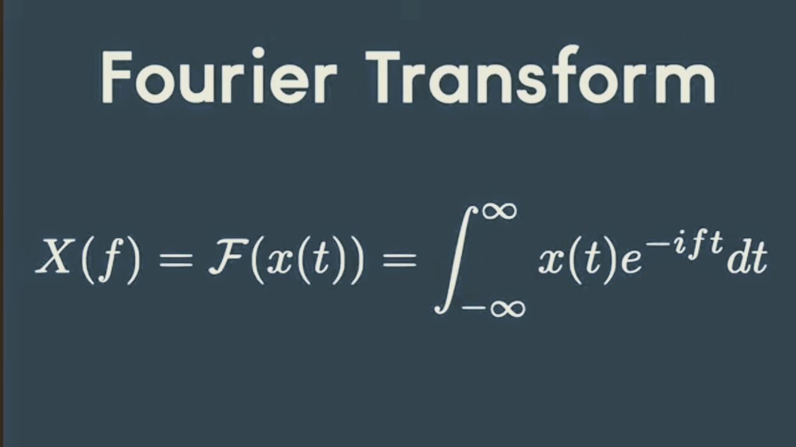
To know FFT , We must know the following question
What is Fourier transform?...
Well, The Fourier Transform is a mathematical technique that transforms a function of time, x(t), to a function of frequency, X(ω). It is closely related to the Fourier Series.
Mathematically,
Source : Wikipedia

Slide 5
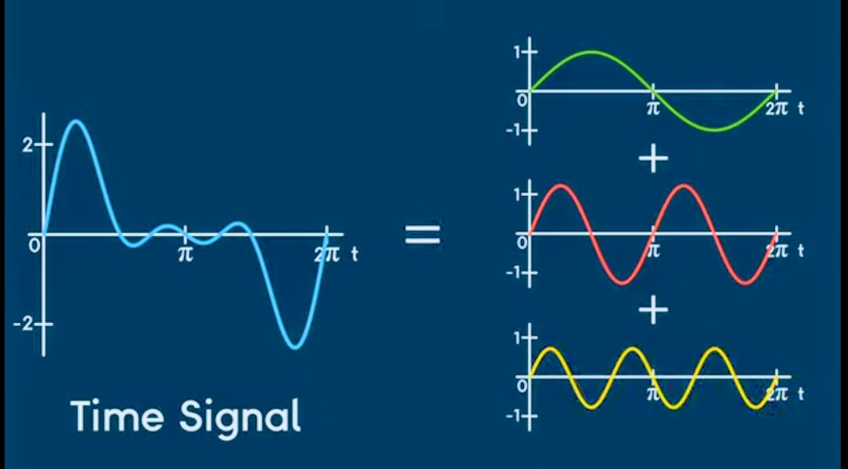
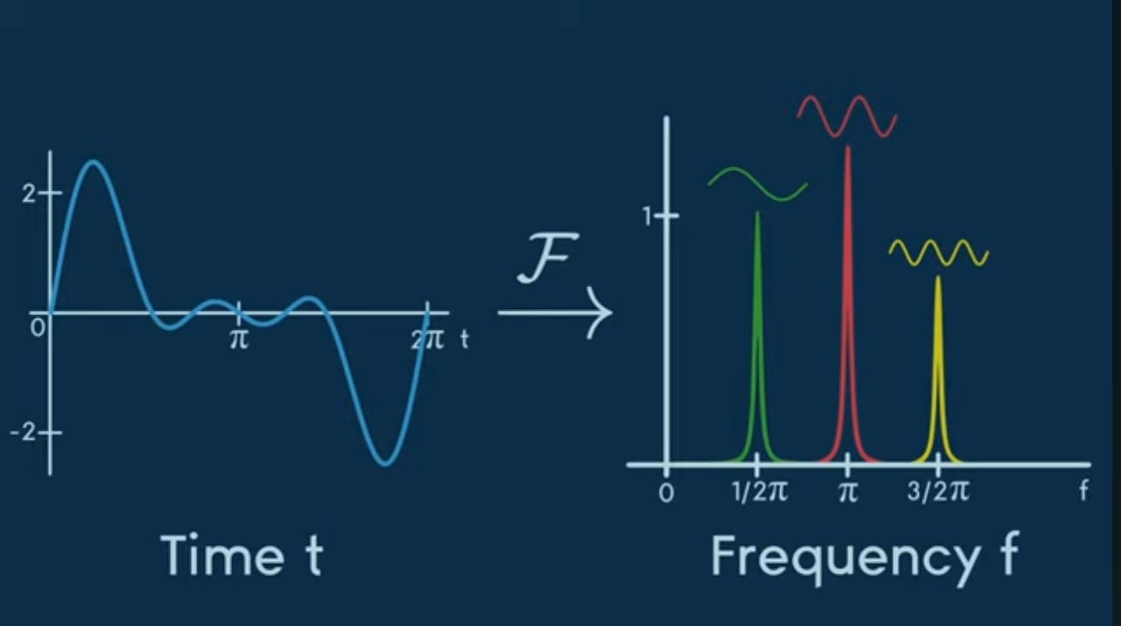
This signal is the result of superposition of another three signals
The signal can be Fourier Transformed into a frequency domain signal
Source: https://www.youtube.com/@MrOrange191

Slide 6
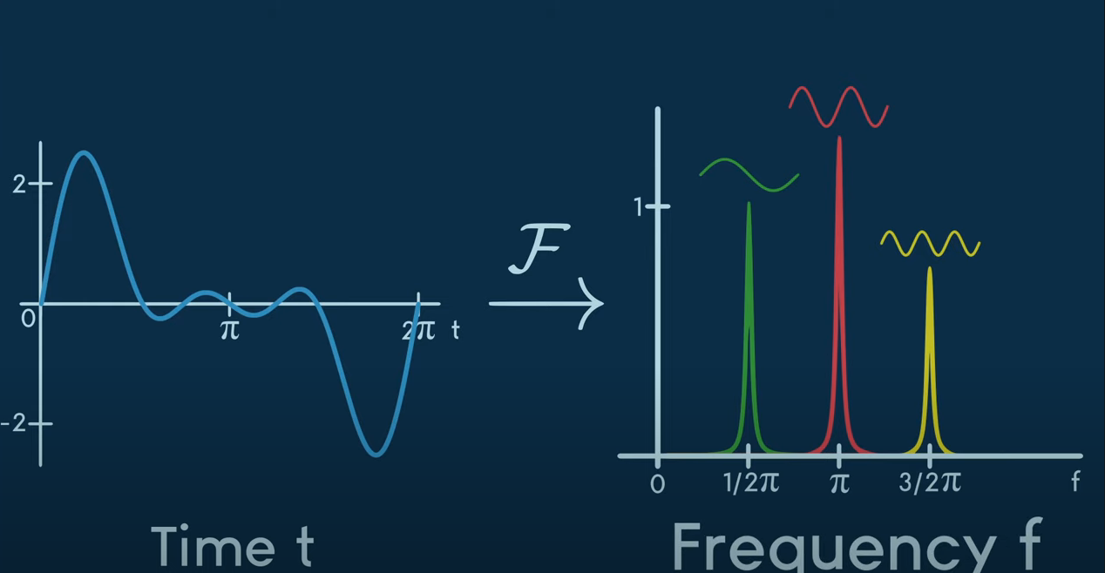
THESE TWO ARE THE SAME SIGNAL. CAN YOU TELL WHICH ONE IS THE SIMPLEST?
Source: https://www.youtube.com/@MrOrange191
One is represented in the time domain and one is in the frequency domain. It is easier to work in the frequency domain as the frequency than that of time domain as the signal remains a lot tangled in the time domain .

Slide 7
What is DFT?
The Discrete Fourier Transform (DFT) allows us to analyze the frequency content of a discrete- time signal. By calculating the DFT of a signal, we can determine the amplitude and phase of each frequency component present in the signal.

Slide 8
What is FFT?
FFT(Fast Fourier Transform) is an algorithm which is based on the principle of decomposing the computation of DFT(Discrete Fourier Transform) of a sequence of length ‘N’ is to smaller transform and combining them to get the overall transform .

Slide 9
RELATIONSHIP BETWEEN DFT AND FFT
An DFT algorithm which decrease the number of computation (thereby decreasing the computation time) is called the Fast Fourier Transform (FFT).

Slide 10
DIFFERENCE BETWEEN DFT AND FFT
FFT:
DFT:
FAST FOURIER TRANSFORM
VARIOUS FAST DFT COMPUTATION TECHNIQUES ARE KNOWN AS FFT ALGORITHM
IT IS AN IMPLEMENTATIONS OF DFT
APPLICATIONS: 1.INTEGER AND POLYNOMIAL MULTIPLICATIONS 2.FILTERING ALGORITHJMS. 3.COMPUTING ISOTROPIC DISTRIBUTIONS. 4.COMPUTIONG FOURIER SERIES CO EFFICIENT.
TAKES UP LESS MEMORY
DISCRETE FOURIER TRANSFORM
IT IS THE ALGORITHM THAT TRANSFORMS THE TIME DOMAIN SIGNALS TO THE FREQUENCY DOMAIN COMPONENTS,SLOW METHOD
IT ESTABLISHES A RELATIONSHIP BETWEEN TIME AND FREQUENCY DOMAIN REPRESENTATION
APPLICATIONS:1.SOLVING PARTIAL DIFFERENTIAL APPLICATIONS. 2.DETECTION OF TARGETS FROM RADAR ECHOES 3.CORRELATION ANALYSIS. 4.COMPUTING POLYNOMIAL MULTIPLICATION 5.SPECTRAL ANALYSIS
USES MORE MEMORY
Source: http://www.differencebetween.net/technology/difference-between-fft-and-dft/

Slide 11
Difference between DFT and FFT working time:
A random signal is generated and compared:
% Number of samples in the signal
N = 64; % Increase this value for larger signals
% Generate a random signal
signal = rand(1, N);
% Compute the DFT
tic;
dft_result = simple_dft(signal);
dft_time = toc;
% Compute the FFT
tic;
fft_result = fft(signal);
fft_time = toc;
% Plotting
figure;
% Plot magnitude of DFT
subplot(2, 1, 1);
stem(0:N-1, abs(dft_result), 'b', 'filled');
title('Magnitude of DFT');
xlabel('Frequency (k)');
ylabel('Magnitude');
xlim([0 N/10]); % Limiting the plot to show only a portion of the DFT
% Plot magnitude of FFT
subplot(2, 1, 2);
stem(0:N-1, abs(fft_result), 'r', 'filled');
title('Magnitude of FFT');
xlabel('Frequency (k)');
ylabel('Magnitude');
xlim([0 N/10]); % Limiting the plot to show only a portion of the FFT
% Display computation times
disp(['Computation time for DFT: ' num2str(dft_time) ' seconds']);
disp(['Computation time for FFT: ' num2str(fft_time) ' seconds']);
% Function to compute DFT
function res = simple_dft(signal)
% Get the number of samples in the signal
N = length(signal);
% Initialize an empty array to store the results (DFT coefficients)
res = zeros(1, N);
% Iterate over each frequency bin (k)
for k = 0:N-1
% Initialize the current DFT coefficient for the given frequency bin
cur_value = 0;
% Iterate over each sample in the signal (n)
for n = 0:N-1
% Compute the DFT coefficient
cur_value = cur_value + signal(n+1) * exp(-2i * pi * n * k / N);
end
% Store the computed DFT coefficient
res(k+1) = cur_value;
end
end

Slide 12
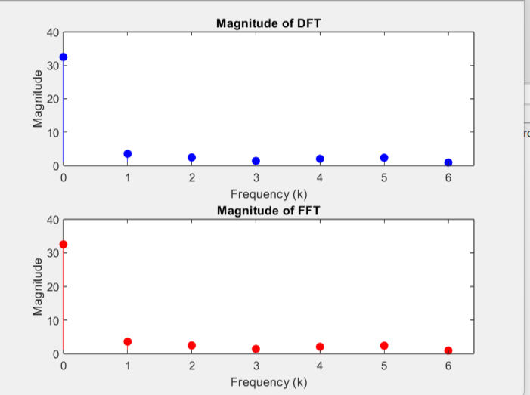
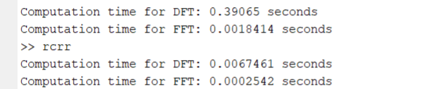
The time reduces by a good margin using FFT when dealing with a larger signal.

Slide 13
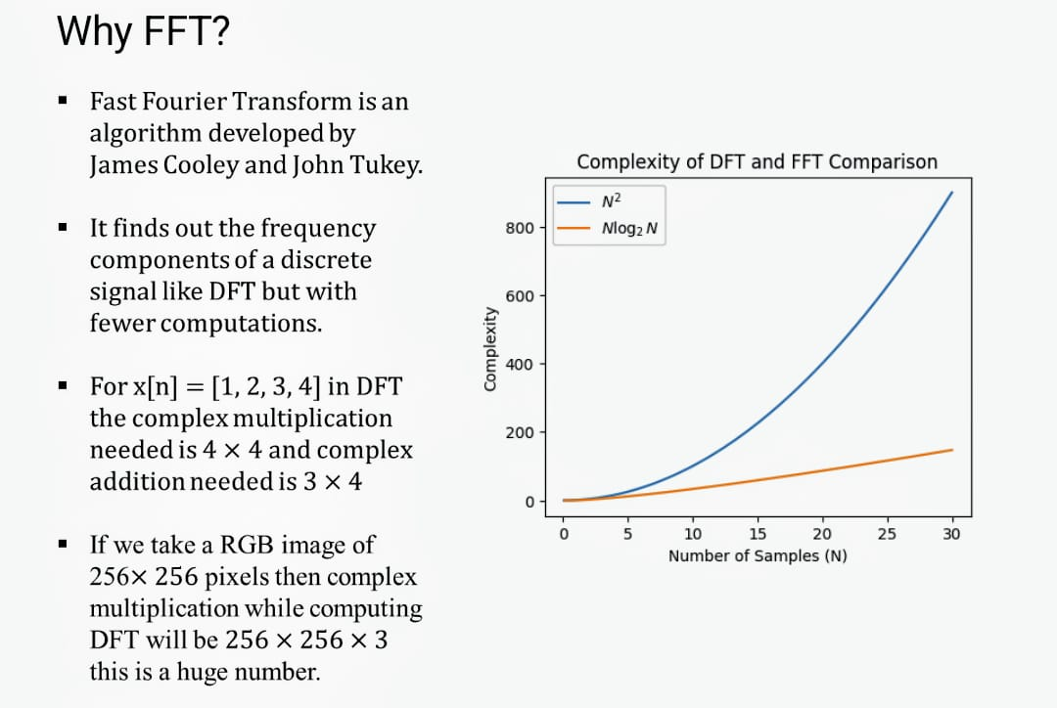
Source: https://www.researchgate.net/figure/Comparison-of-the-computational-complexities-of-DFT-FFT-and-QFT-algorithms_fig2_338980039

Slide 14
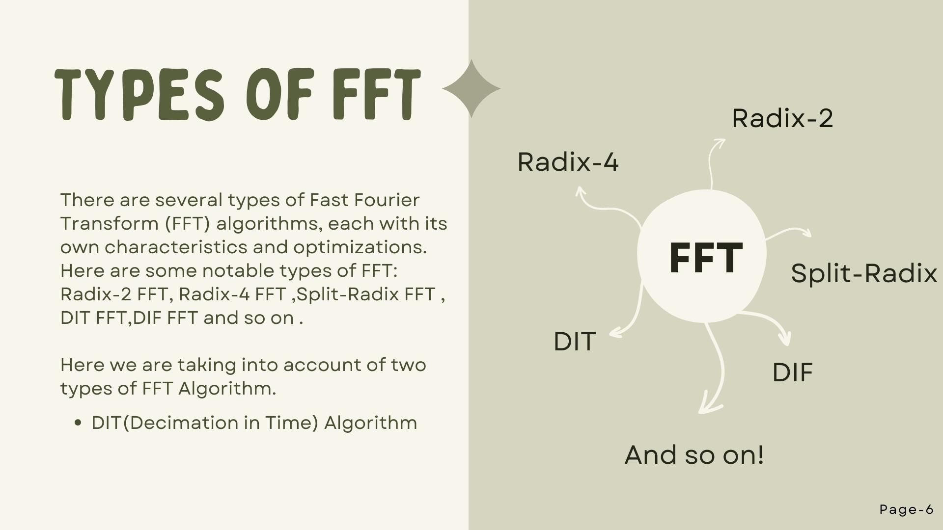


Slide 15
Some examples of FFT are given in the following slides:

Slide 16
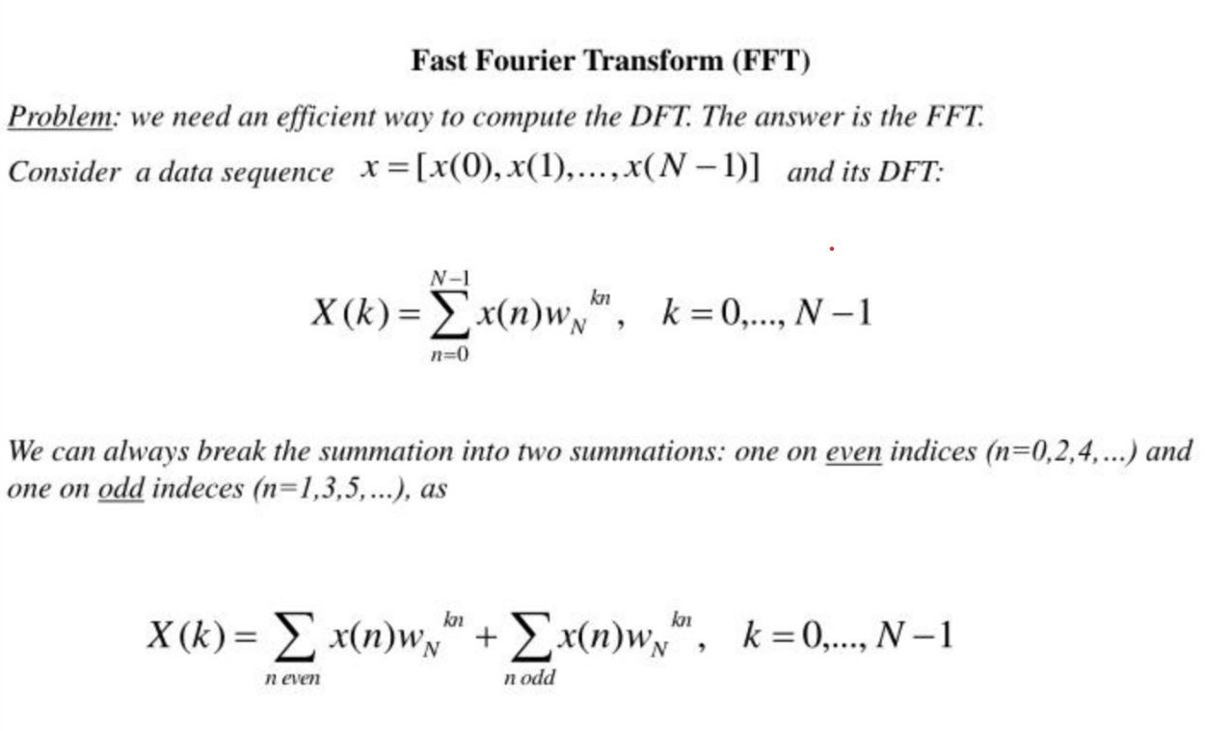

Slide 17
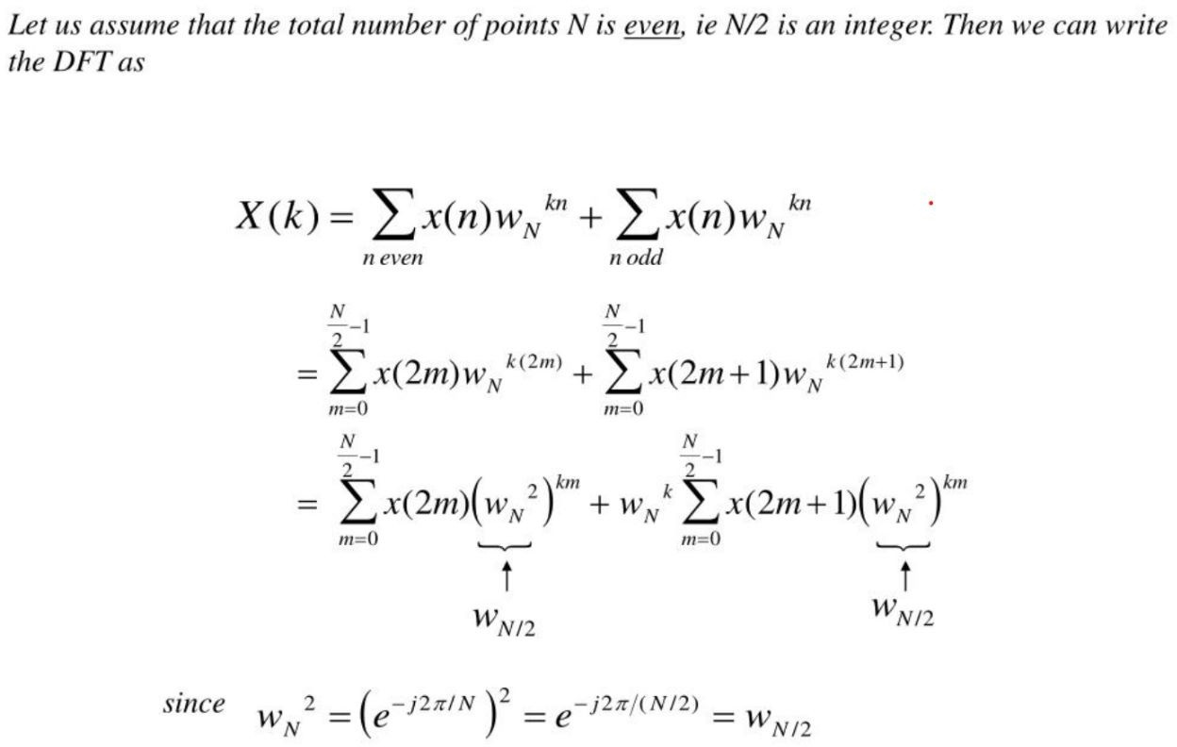

Slide 18
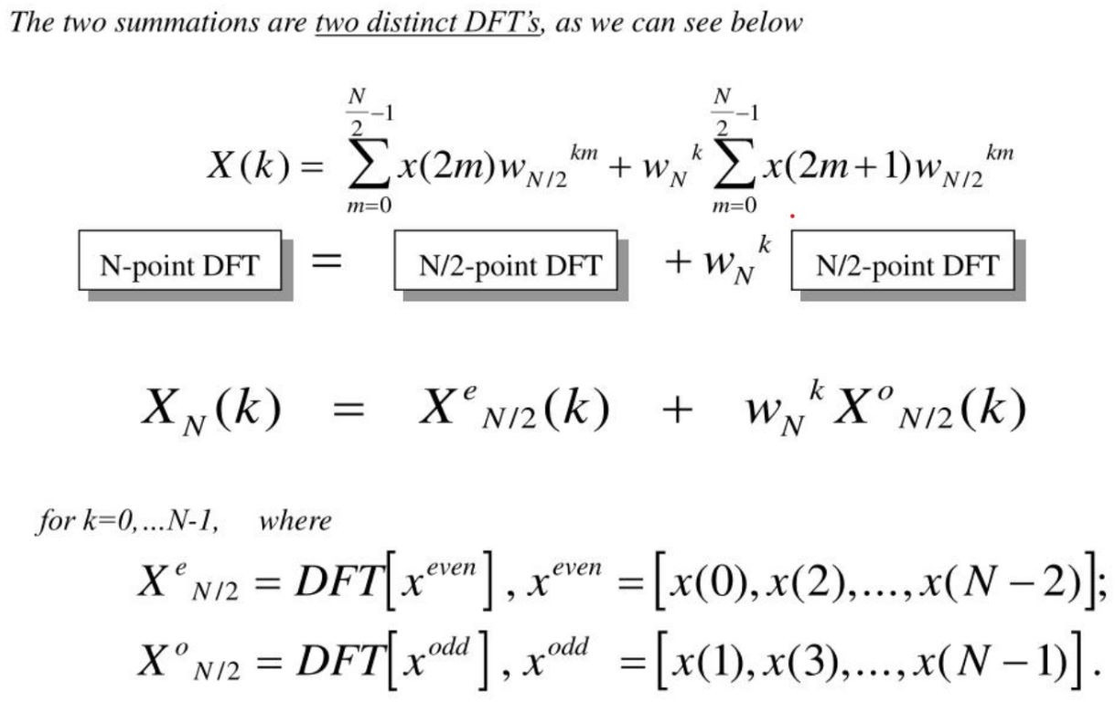

Slide 19
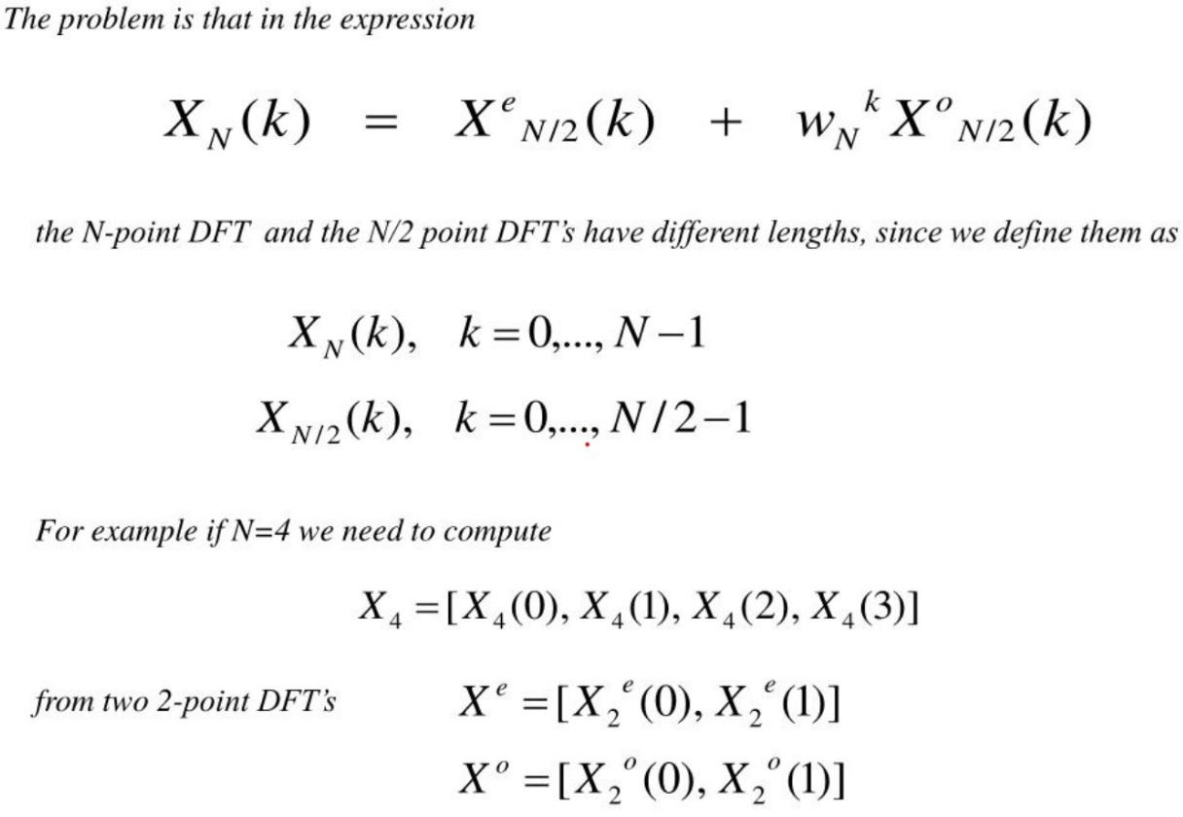

Slide 20
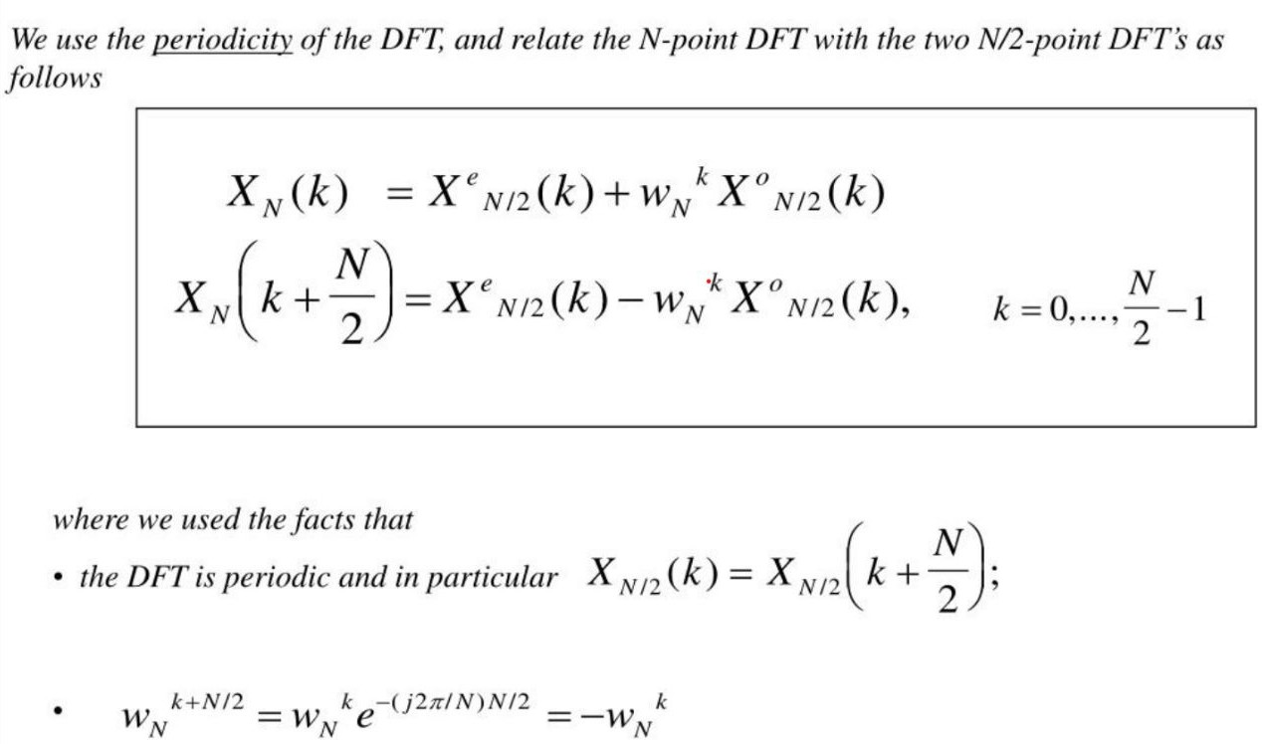
Source: MATHEMATICS OF THE DISCRETE FOURIER TRANSFORM (DFT) by
JULIUS O. SMITH III

Slide 21
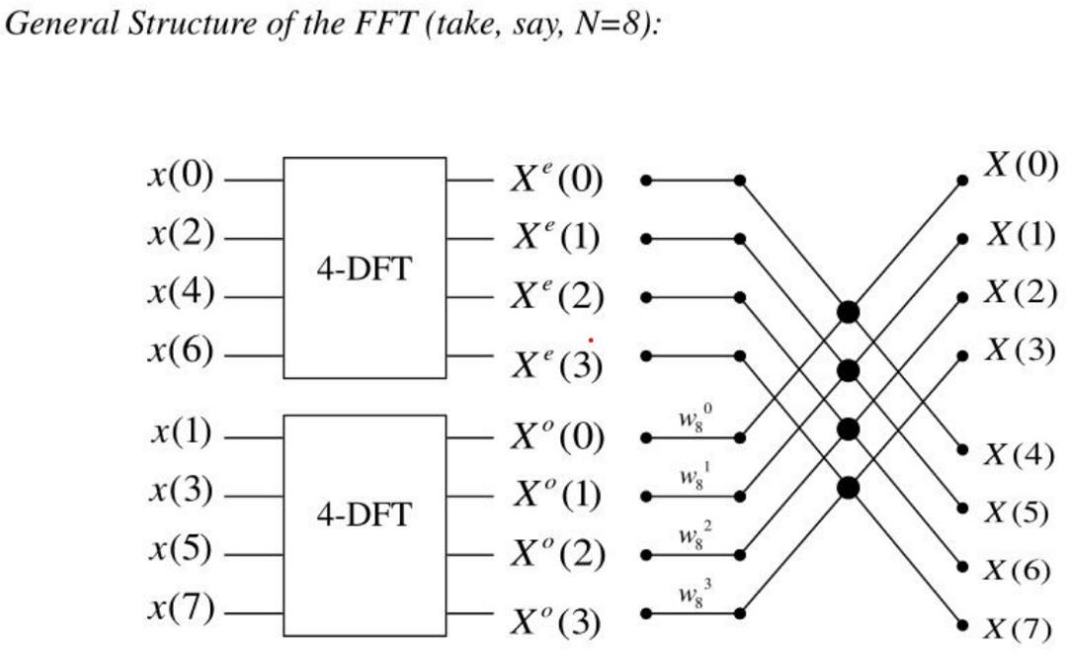

Slide 22
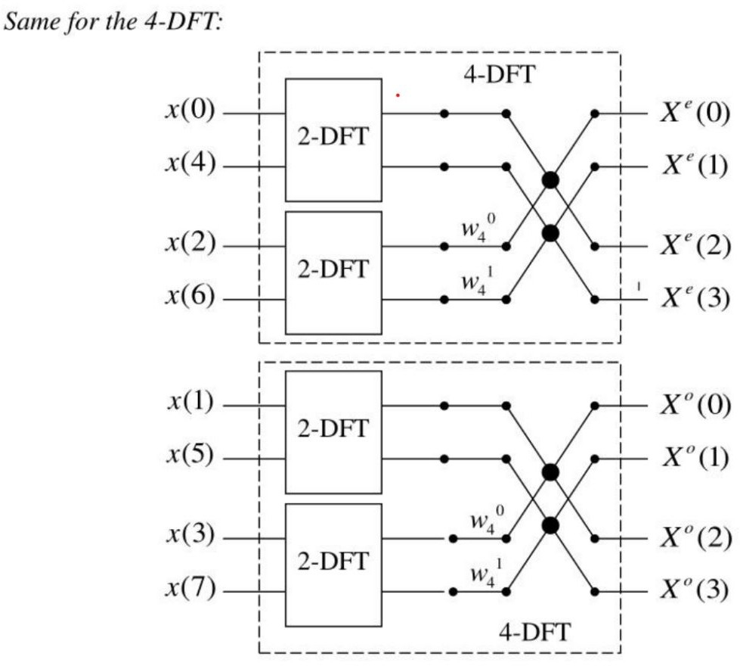

Slide 23
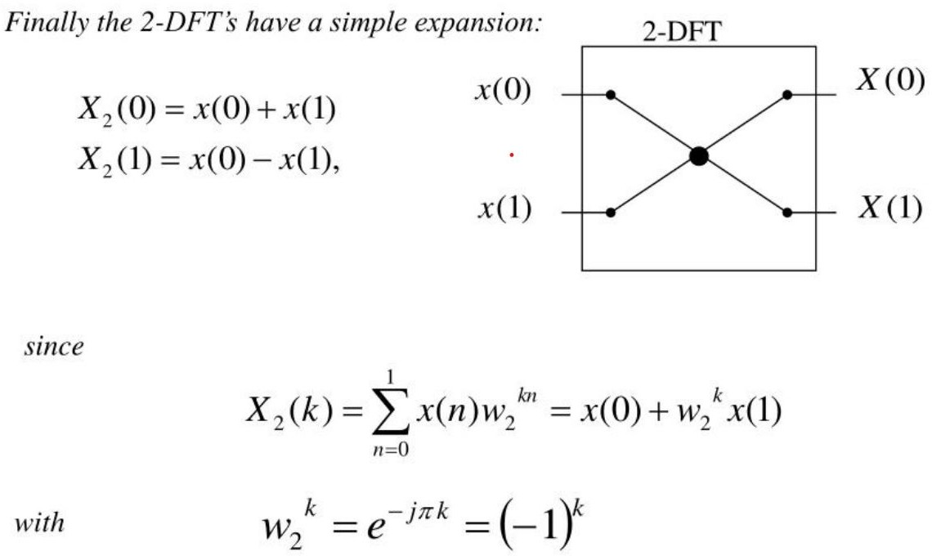

Slide 24
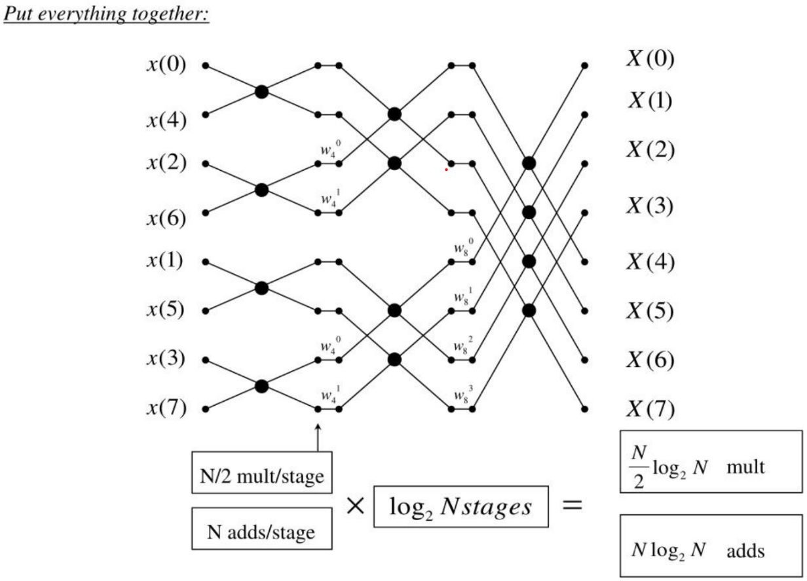
Source: Fourier Transforms and the Fast Fourier Transform (FFT) Algorithm by Paul Heckbert

Slide 25
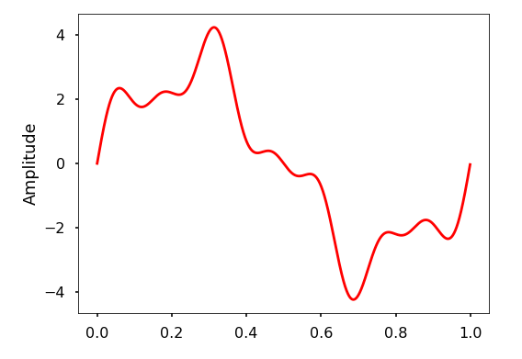
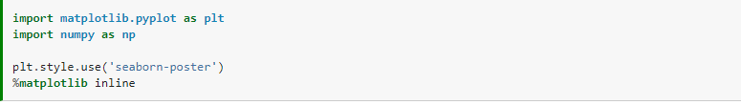
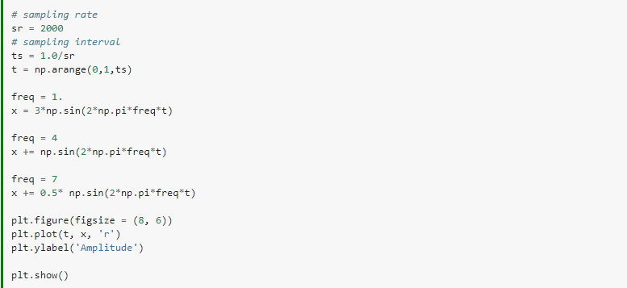
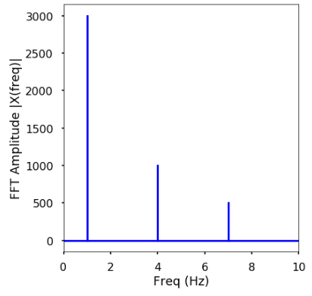
Let’s see one example:
What that signal would be in frequency domain?
With python the signal can be transformed.
The frequency domain signal.

Slide 26
FFT DEMONESTRATION:
Fast Fourier Transform (FFT) is used in various real-life applications across different fields. One common example is in signal processing, where FFT is employed to analyze signals in domains like telecommunications, audio processing, and image processing. For instance, in telecommunications, FFT can be used to transform signals from the time domain to the frequency domain, allowing for efficient filtering, compression, or modulation/demodulation of signals. In audio processing, FFT is used in tasks such as spectral analysis, equalization, and noise reduction. Similarly, in image processing, FFT can be utilized for tasks like image enhancement, compression, and pattern recognition.

Slide 27
Pitfalls of Fast Fourier Transform
The main problem is the requirement to use strictly the signals of a certain length for FFT, and the signal length in the samples should be 2 raised to some power. It’s possible to make FFT with array of 1024 (512 or 2048) signal points but not of 1000 (500 or 2000) points. As a result a simple calibration signal of 1KHz frequency, shot on the sampling rate of 10 MHz, cannot be subject to FFT on its period length which will compose 1000 points in these terms. There can be two variants: you will have to use a bigger area for the analysis – 1.024 of the signal period (in that case the signal spectrum will be distorted, because FFT should be made exactly on the area of the signal period or the area multiple to it) or to make the oversampling of 1000-pointed signal to the virtual sampling rate of 10.24 MHz (in this case there is a possibility to distort waveform due to the interpolation used, that will also cause the signal spectrum distortion).
Another problem is the waveform discreteness. The signal can be measured in the certain points of time and the information about its condition in the intervals between these points is absent. As a result simple waveform instability across of ±1 sample, when the sampling rate is relatively low, can cause visual distortion. For example, on a oscilloscope display with the length of 1024 points there are 20-30 periods of the signal under investigation. That will correspond to 30-50 measurement points for one period, i.e. the error in 1-2 samples causes the error of FFT period of 2-7% which will be expressed in significant false artifacts on the spectrum image.
Source: https://www.tmatlantic.com/encyclopedia/index.php?ELEMENT_ID=14944

Slide 28
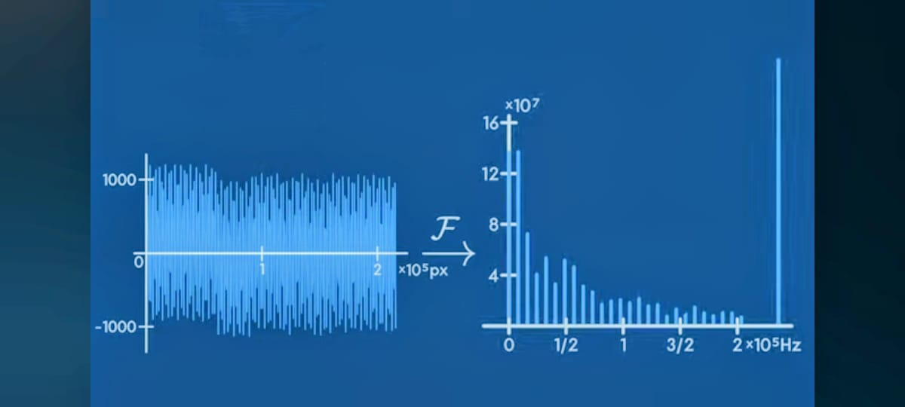
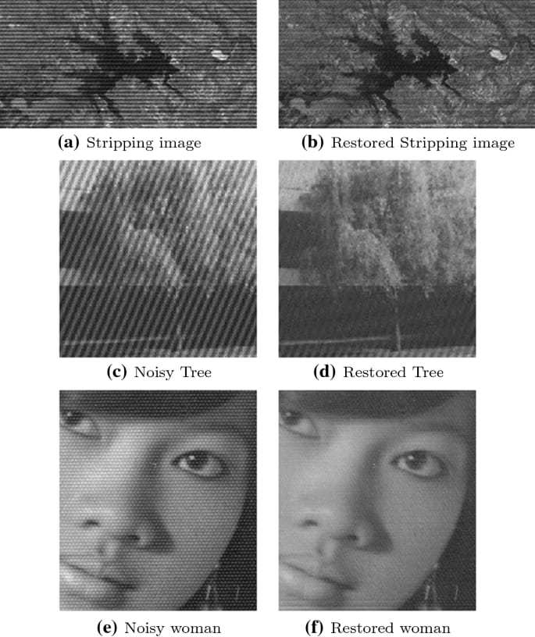
FFT’s Use in Restoring Noisy Images:
Source: https://www.youtube.com/watch?v=bpn3DEULv8g
By doing FFT we can distinguish the noise frequency from the normal ones easily and by removing that noise frequency we can restore an image to its original form. So in the modern era FFT is one of the most important tools for noise reduction.

Slide 29
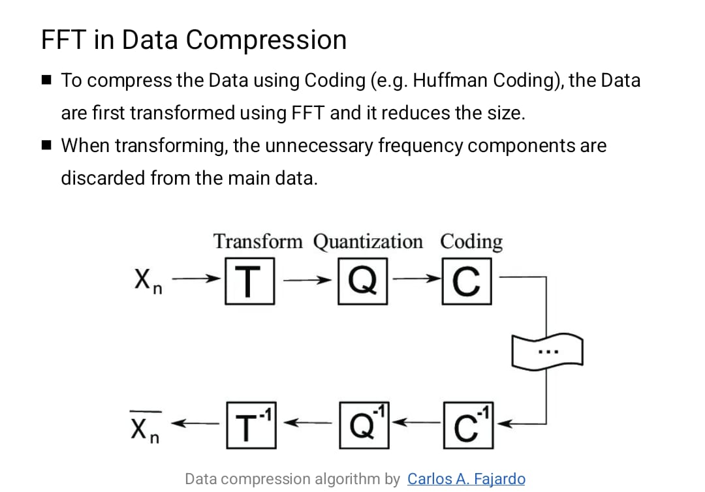

Slide 30
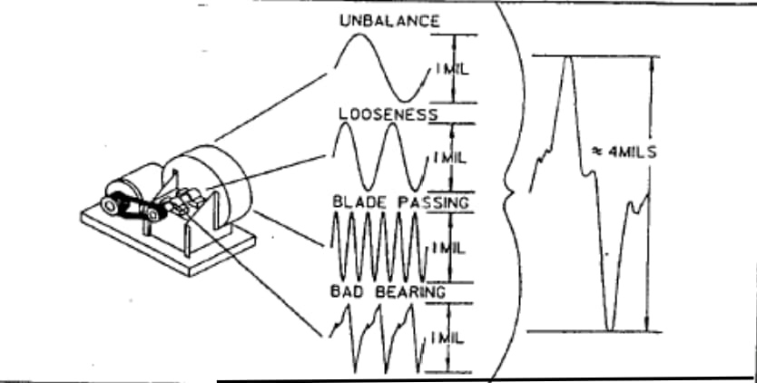
FFT IN VIBRATION ANALYSIS
WHEN THE TRANSDUCER IS PLACED ON THE MACHINE, IT”’s ELECTRICAL OUTPUT IS A CONTINUOUS ANALOG SIGNAL REPRESENTING THE VIBRATION AT THAT LOCATION.
It contains all of the information in either velocity, displacement or acceleration.
If there is only a single problem in a machine, then it will be a sin wave.
But in real world, there will be a multiple sources of vibrations .
IT PRODUCES A COMPLEX WAVE
Source :https://www.youtube.com/watch?v=owOgIZivmC8

Slide 31
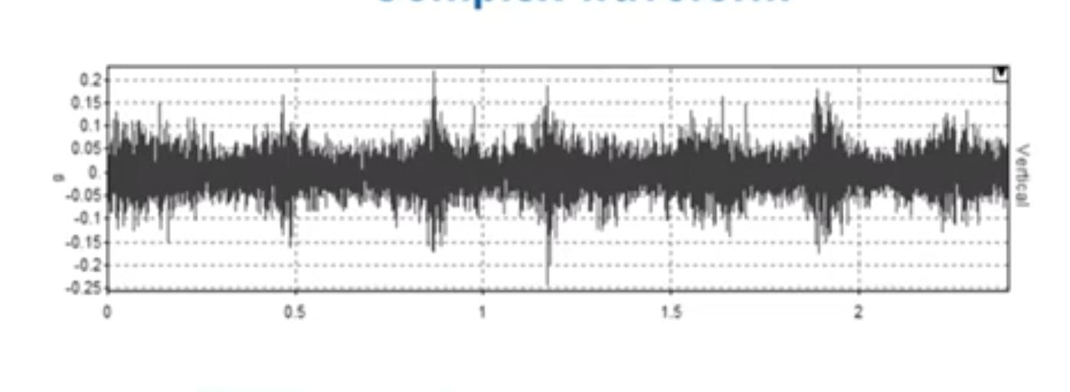
COMPLEX WAVEFORM IN TIME DOMAIN:
In vibration analysis for machine vibrations, Fast Fourier Transform (FFT) is a powerful tool for efficiently analyzing complex waveforms generated by the machine's vibrations. Here's how it works:
Data Collection: Vibration data is collected from sensors placed on the machine. This data represents the complex waveform of the machine's vibrations over a period of time.
Preprocessing: Before applying FFT, the raw vibration data may undergo preprocessing steps such as filtering to remove noise or artifacts that could distort the analysis.
FFT Calculation: The FFT algorithm is applied to the preprocessed vibration data. FFT transforms the data from the time domain to the frequency domain, revealing the frequency components present in the vibration signal.
Frequency Analysis: Once transformed, the frequency spectrum obtained from the FFT provides valuable insights into the dominant frequencies and their amplitudes in the machine's vibrations.
Interpretation: Engineers analyze the frequency spectrum to identify any abnormal peaks or patterns that could indicate underlying issues such as mechanical faults, resonance, or imbalance in the machine
Diagnosis and Maintenance: Based on the analysis, engineers can diagnose the root causes of vibration problems and plan appropriate maintenance or corrective actions to address them, preventing potential failures and optimizing the machine's performance and lifespan

Slide 32
Some more applications
The Fast Fourier Transform (FFT) algorithm is widely used in various fields for efficient computation of the Discrete Fourier Transform (DFT) and its inverse. Here are some common applications of FFT:
Signal Processing: FFT enables the analysis, filtering, and modification of signals in the frequency domain.
Image and Video Compression: Transform-based image and video compression techniques, like JPEG and MPEG, employ FFT to convert the spatial domain data into the frequency domain.
Communication Systems: FFT is essential in menables spectrum analysis, channel equalization, and demodulation techniqu like OFDM (Orthogonal Frequency Division Multiplexing).
Speech Recognition: FFT is utilized to extract relevant features. These features are then used for tasks like speech recognition, speaker identification, and speech synthesis.
Medical Imaging: Techniques like Magnetic Resonance Imaging (MRI) and Computed Tomography (CT) heavily rely on FFT for image reconstruction and enhancement.
Radar and Sonar Systems: FFT plays a crucial role in processing radar and sonar signals for target detection, range estimation, and Doppler analysis.
Astrophysics and Cosmology: In the field of astrophysics, FFT is utilized in various applications, including the analysis of astronomical data, gravitational wave detection, and radio astronomy.
Data Analysis: FFT is employed in various data analysis tasks, such as spectral analysis, noise removal, and pattern recognition.
And where not??
Source :Reddit

Slide 33
Thankyou for your patience :)
Any Questions?

